Slide 1
CG4002 Final Presentation
Group 2
Ong Kan Wu (A0258702A)
Cheong Chen Kang (A0258239U)
Dheekshitha Murali Krishnan (A0256963N)

Slide 2
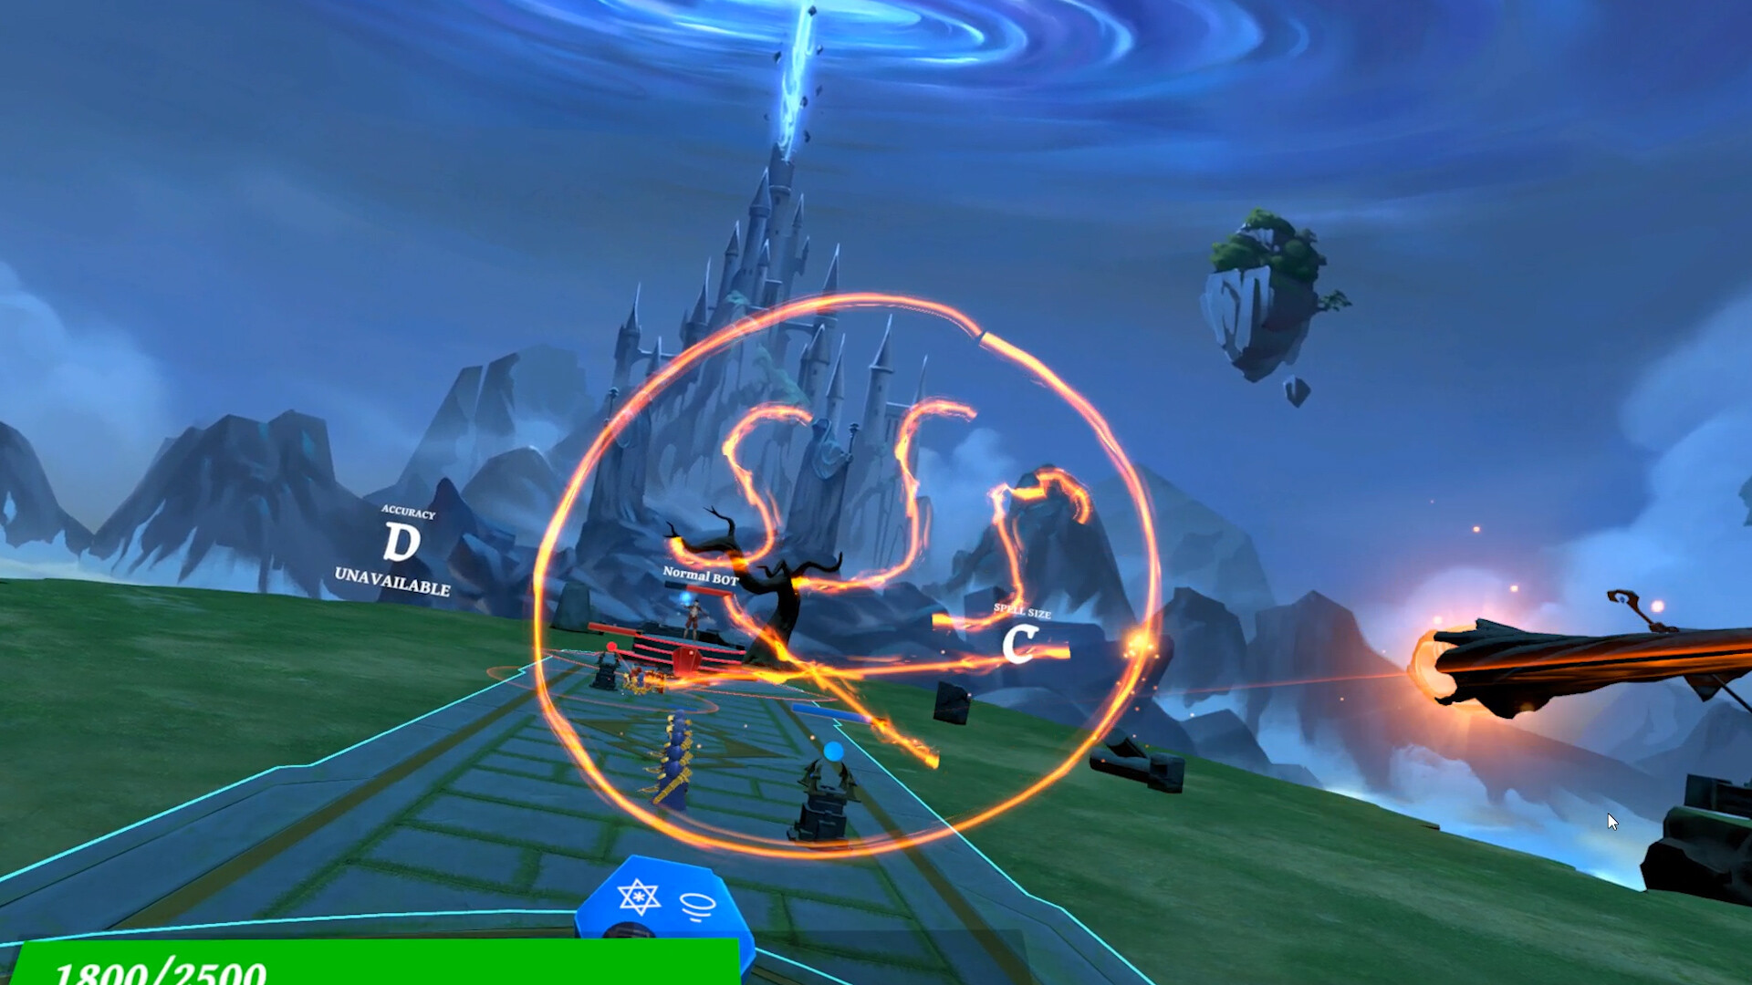
Overview
Our project is a 2 player game, where players draw and cast spells, in order to defeat the opposing opponent.

Slide 3
Game Logic

Slide 4
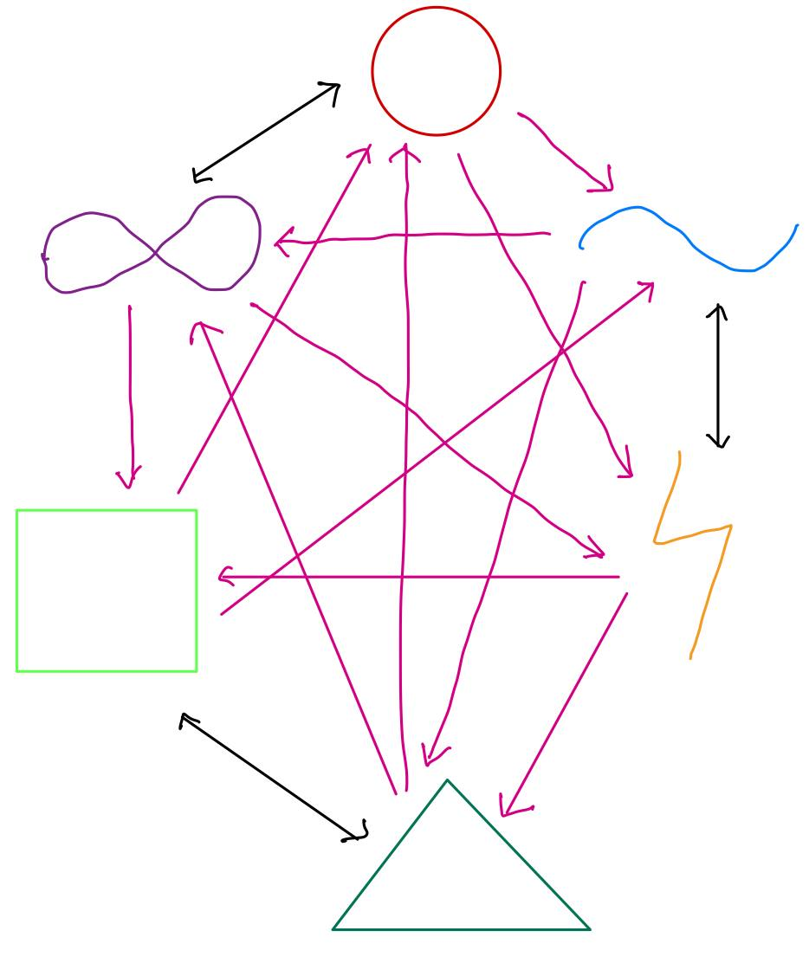
Spell Types
Clashing logic:
If spell draws, spell with strongest strength wins, and gets weakened
If spell wins by element advantage, spell won't weaken

Slide 5
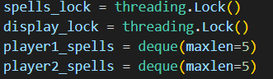
Game engine setup
Run in separate thread in parallel with comms and AI prediction on the ultra 96
Preventing race conditions using thread locks.
Calculating of spell position and player health as well as refreshing of the screen will be done approx every 0.5ms

Slide 6
Game algorithm
Game Algorithm
Position Calculation Thread
Pause detection Thread
Unpause detection Thread
Initialize Game
Player1/2 Health: 3
Pause detected?
Send game end packet
No
Yes
Game end?
Get Paused time
Send game state packet
Set Game as not ready
No
Unpause detected?
No
Game Ready?
No
Yes
Clear MPU buffer
Update time, add the diff between pause and unpause time to the spell’s original cast time
Deal with colliding spells
Check for any damage done/ game end
Calculate and Send spell position + player health packet

Slide 7
Wand In drawing mode.
Streams MPU data to U96
Mpu data buffer fills up, and AI starts making predictions
AI predicts data and sends prediction to wand
Wand goes to casting mode.
Lights up LED (colour based on spell type, brightness based on strength
When thrust detected, wand sends packet to U96, with strength and spell type info
U96 detects that spell is casted, and adds the spell to the queue for game engine to handle

Slide 8
Hardware

Slide 9
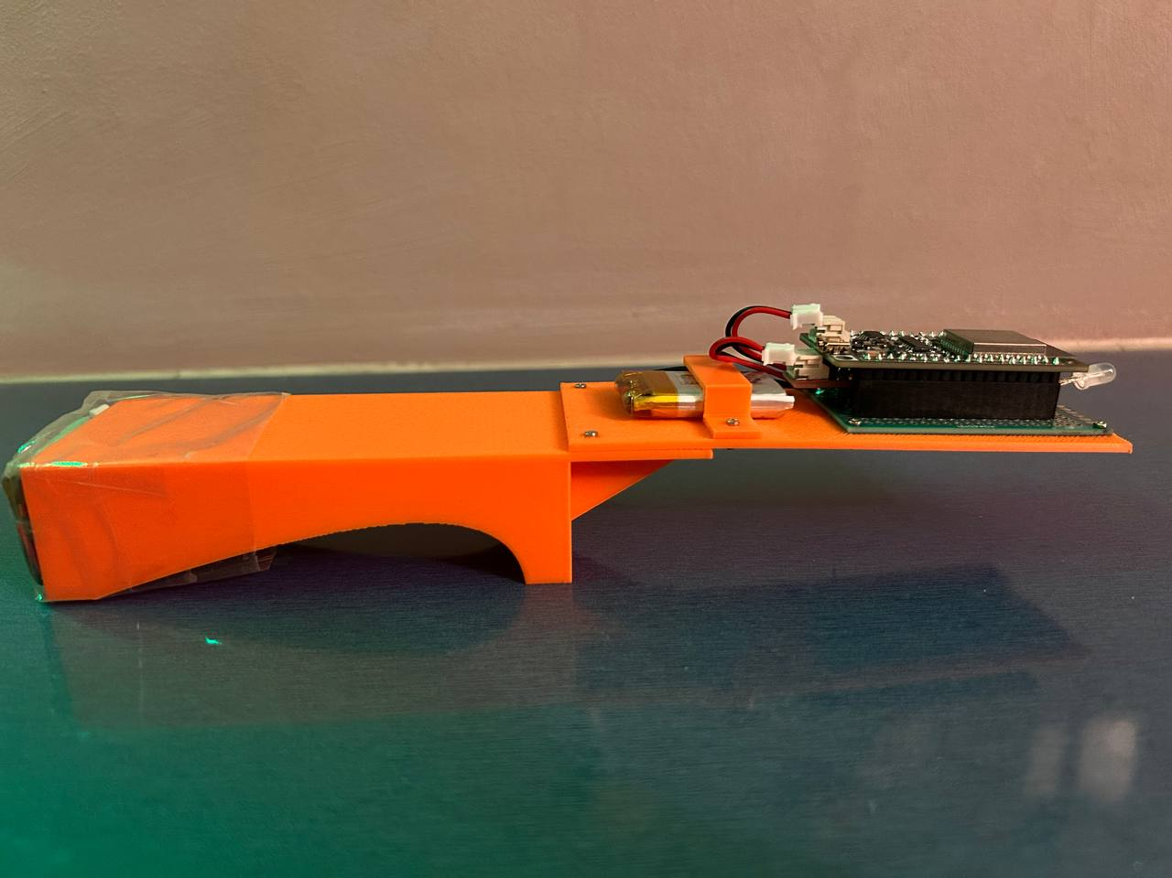
Components used
ESP32 Firebeetle
Receive and transmit data to Ultra96
Control LED colour and strength
MPU6050
Collect roll,pitch,yaw as well as 3-axis accel using in built Digital Motion processing
LED
Indicate spell strength, based on amount wand spins
Indicate spell type, based on what AI predicts
MAX17043
Battery Fuel gauge to detect battery level

Slide 10
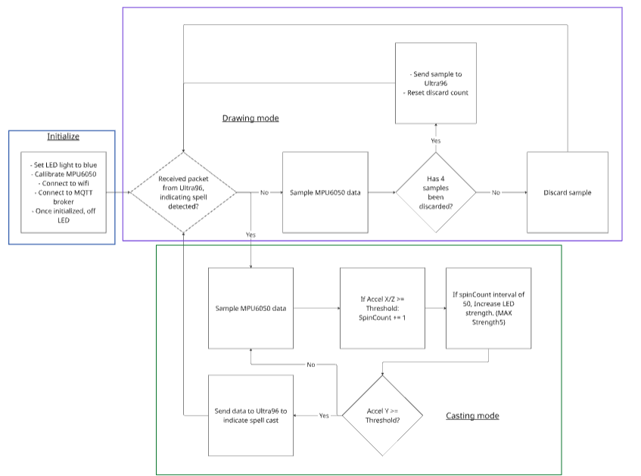
Wand State Diagram

Slide 11
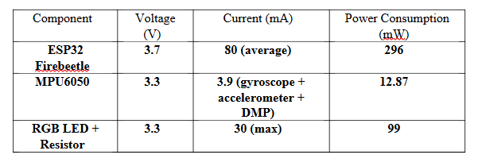
Power and Energy Consumption
600mAh battery chosen as power source
5.27hrs of run time, less recharge required, less wear if we do not leave battery to drain
Total power consumption: 296 + 12.87 + 99 = 407.87mW
Energy consumption for 1 wand per game (5 min): 407.87 x 5 / 60 = 33.99mWh = 122.37J.

Slide 12
Comms

Slide 13
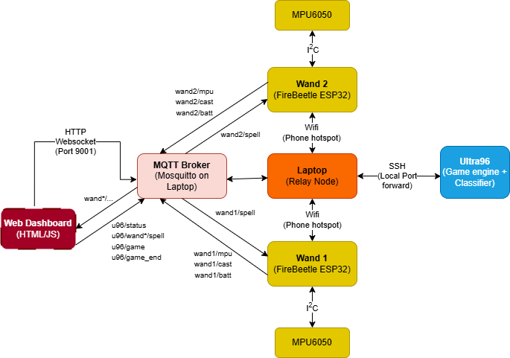
System architecture

Slide 14
Topics
Subscribed (server.py):
wand1/status (q1) wand2/status (q1)
wand1/batt (q1) wand2/batt (q1)
wand1/mpu (q0) wand2/mpu (q0)
wand1/cast (q2) wand2/cast (q2)
Published (server.py):
u96/status (q1, retain=True) // readiness + wand states
u96/game (q0, retain=True) // battlefield frame
u96/wand1/spell (q2) // result back to wand 1
u96/wand2/spell (q2) // result back to wand 2
u96/game_end (q1, retain=True) // winner
QoS 0 (fast): noisy telemetry where only the latest matters
QoS 1 (reliable): state snapshots that must arrive; duplicates OK
QoS 2 (exactly once): side-effecting commands that must not duplicate

Slide 15
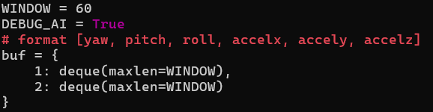
Uplink framing - Pkt format + AI inputting
AI Window in server.py:
Expected MPU/cast payloads (ESP32 → MQTT):
// wand*/mpu (q0)
{"yaw":-12.3,"pitch":3.4,"roll":1.0,"accelx":0.12,"accely":-0.04,"accelz":0.98}
// wand*/cast (q2) — one per gesture
{"spell_type":"Z","strength":4}

Slide 16
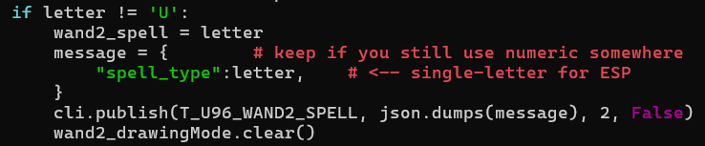
Downlink & game loop
Server.py:
in AILoopPlayer1/2 after infer
Battlefield frame every 0.5s
UPDATE_INTERVAL = 0.5
image = {"player1_hp":p1, "player2_hp":p2, "battlefield":spell_display}
cli.publish(T_U96_GAME, json.dumps(image), qos=0, retain=True)
Collision & damage rules (example):
# when lanes meet: compare letters + strengths
winner = getCollidingSpellWinner()
# positions: left→right for P1, right→left for P2
def calculatePosition(t, now, is_p1):
pos = int((now - t)/2)
return pos if is_p1 else 4 - pos

Slide 17
Reliability & concurrency (what keeps it stable)
Events/Locks: connected, gameReady, pauseState, per-wand mutex for IMU buffers, spells_lock to serialize edits.
Back-pressure: deque(maxlen=60) for IMU windows; player*_spells = deque(maxlen=5) prevents spam; 2-second anti-spam guard.
Framing: newline-delimited JSON (inside server’s TCP side if you add a raw socket path; MQTT already frames).
QoS strategy: telemetry = 0, decisions/results = 2/1
LWT: will_set(u96/status, ready:false, retain) so dashboards know if Ultra96 dies.
Retain: u96/game retained → late browser still sees the last frame

Slide 18
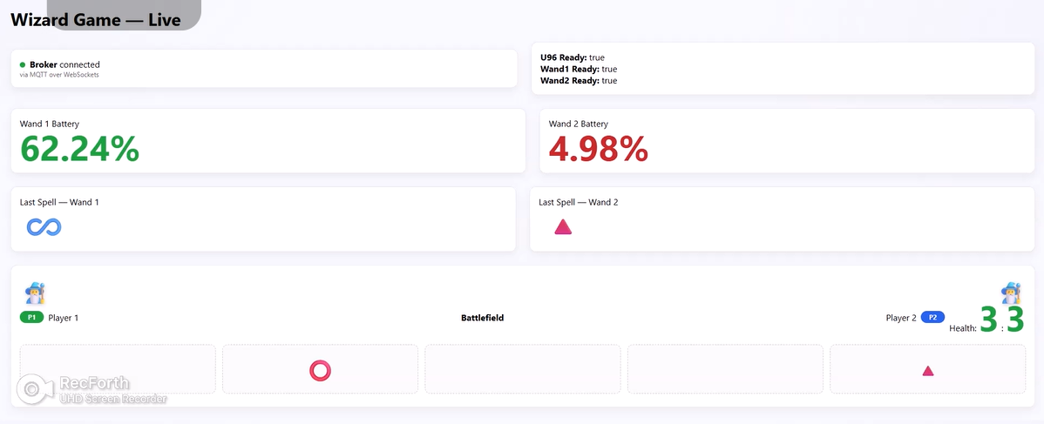
Webpage

Slide 19
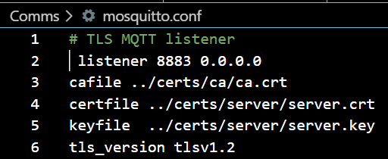
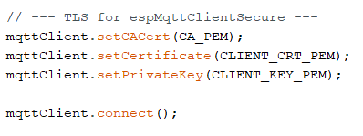
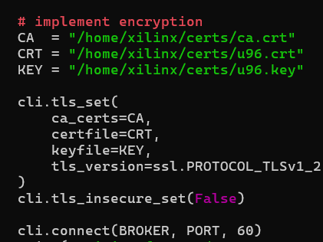
Encryption
In Mosquitto:
In ESP32:
In server.py:

Slide 20
AI

Slide 21
AI Model (1D CNN)
CNN captures local temporal features in IMU signals
Fewer parameters → faster and lighter for embedded use
More robust to timing shifts and noise
Better generalization and higher accuracy on gesture data

Slide 22
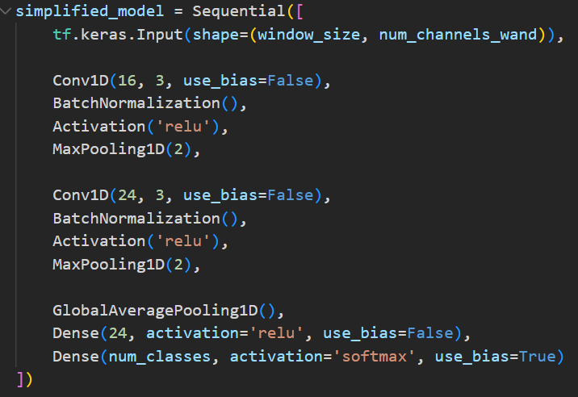
Challenges and Features
Limited computational resources on embedded hardware.
Innovation: Designed a lightweight CNN to minimize parameters while keeping accuracy high. BatchNormalization folding to remove unnecessary operations during inference.

Slide 23
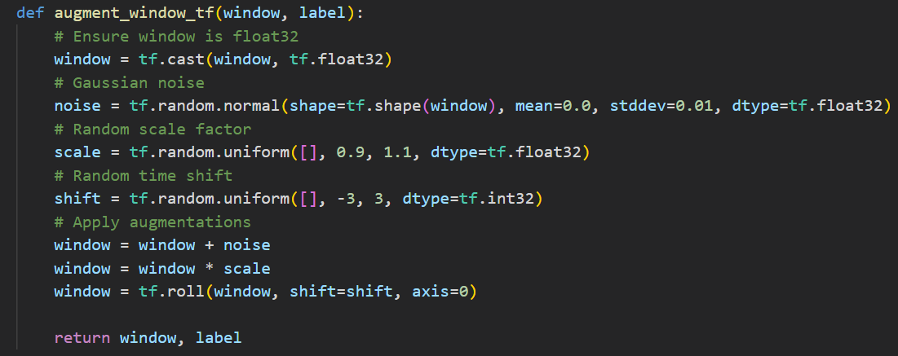
Challenges and Features
Inaccuracy on unseen data. Sensor noise and variability.
Innovation: Added Gaussian noise, random scaling, and time shifting during training to simulate real-world conditions.

Slide 24
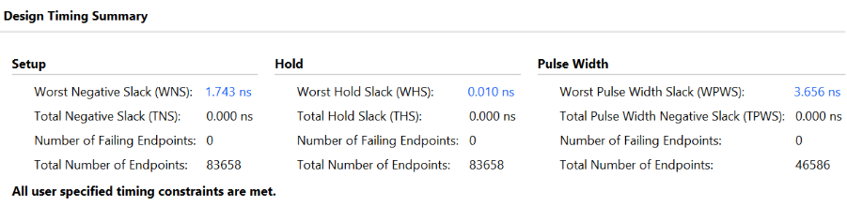
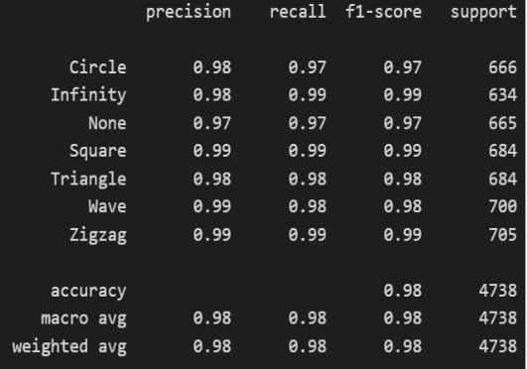
Metrics

Slide 25
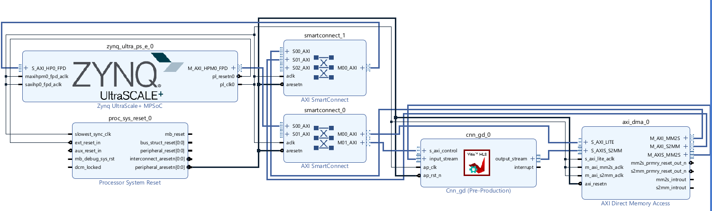
Block Design
Used in Vivado to generate bitstream

Slide 26
Data and Flow control
The IMU collects 6-channel motion data (accelerometer + gyroscope) at 20 Hz.
Each gesture is captured as a 3-second window (60 timesteps), normalized using precomputed mean and standard deviation.
Preprocessed data is fed into the embedded CNN model, which predicts one of 7 gesture classes (Circle, Infinity, None, Square, Triangle, Wave, Zigzag).
The predicted gesture is transmitted to the game screen.

Slide 27
Thank you!

